Slide 1


Agile Retrospectives
Notes:
Welcome to this training on retrospectives.
The timeframe for this training is approximately 2 hours after which there will be time for Q&A.
The contents of this presentation are licensed under a Creative Commons Attribution-ShareAlike 4.0 International License.
For more information about the license, visit:
http://creativecommons.org/licenses/by-sa/4.0/

Slide 2
Today’s Schedule
What?
How?
Why?
Notes:
Today we will look at the following topics:
Why do we do retrospectives.
How to do a retrospective, were we will go through the theory of retrospectives, how they are structured and will look at some examples of each phase in a retrospective.
What do we do in retrospectives. Last but not least we will go through several tips & tricks from real life retrospectives and an overview of resources to learn more about retrospectives.

Slide 3

Notes:
But first we will play a game!
[Notes for presenter]
Play a ball game:
3 balls are used in this game.
Make sure a roll of duct-tape is available.
1 person needs to keep time.
1 person needs to record the results on a flip chart.
A group of 6 to 8 people need to pass/throw the balls around. After this first round the group needs to iterate and evaluate to do it faster each iteration with the following requirements:
The order in which the 3 balls are passed needs to stay the same.
Each person needs to make contact with all the balls one by one.
Anything else is allowed.
At the end of each iteration the group evaluates and discusses improvements.

Slide 4

Notes:
Observe and discuss the results of the ball game with the entire group of training participants.

Slide 5
WHY?
Notes:
To learn how we can do retrospectives, first we need to understand why we do them.

Slide 6
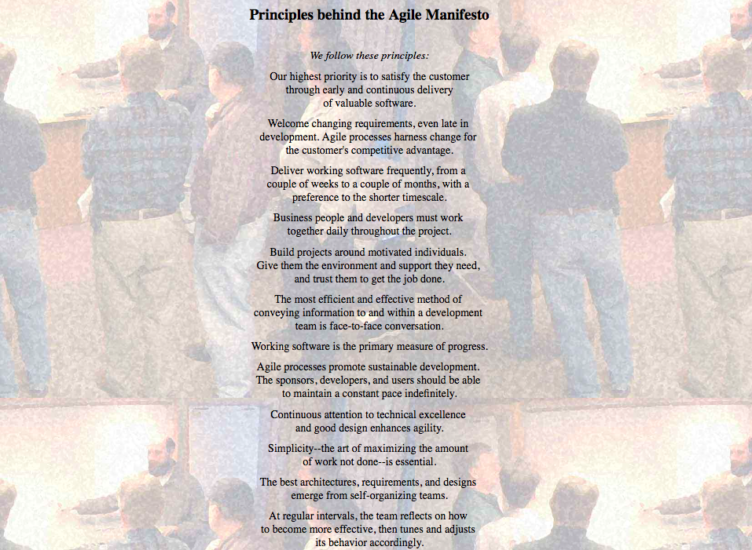
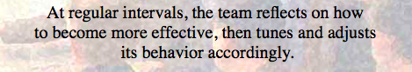
Why do we do retrospectives?
WHY?

Slide 7
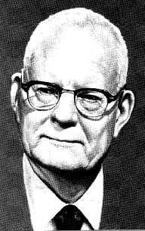
Why do we do retrospectives?
W. Edwards Deming
WHY?

Slide 8
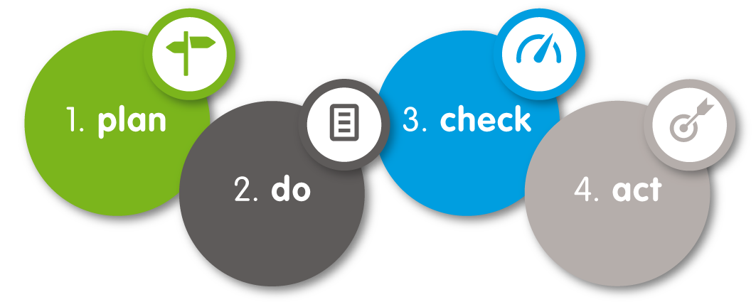
Why do we do retrospectives?
WHY?

Slide 9
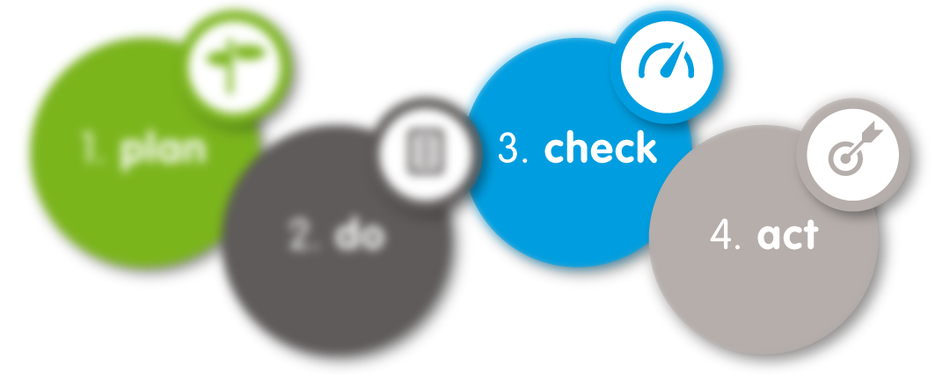
Why do we do retrospectives?
WHY?

Slide 10
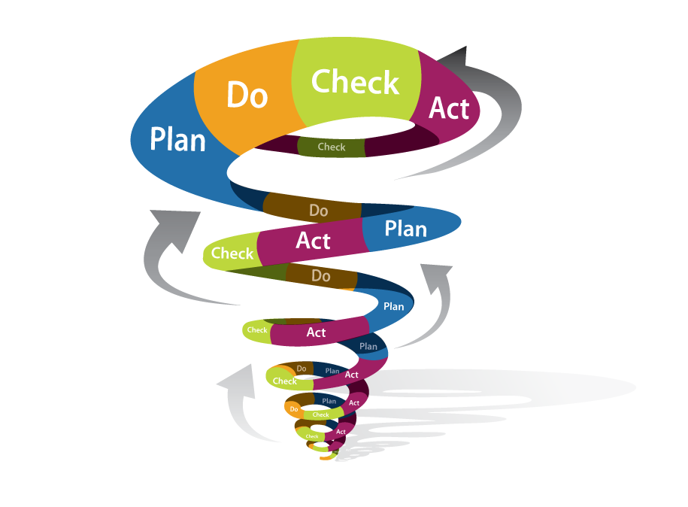

Why do we do retrospectives?
WHY?

Slide 11
Why do we do retrospectives?
What if we don’t?
WHY?

Slide 12
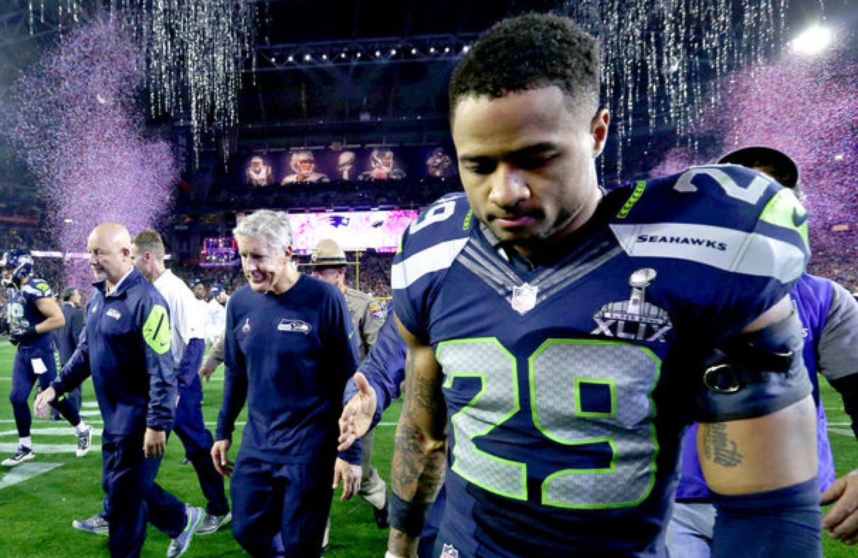

Slide 13
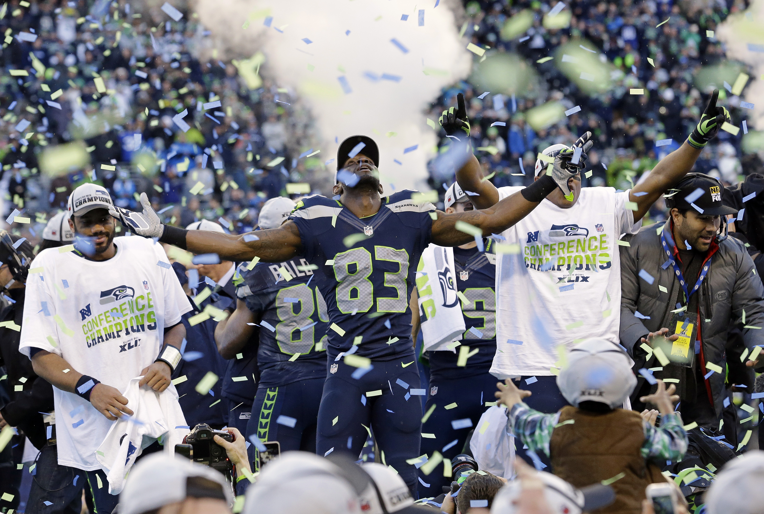

Slide 14
HOW?

Slide 15

The Scrum process
Sprint retrospective
HOW?

Slide 16
The Retrospective
Each sprint should have a retrospective.
It is the last activity in the sprint.
Allocate time for it.
Use the outcomes.
HOW?

Slide 17
Retrospective structure
Set the Stage
Gather Data
Generate Insights
Decide What To Do
Close
HOW?

Slide 18

Set the stage

Slide 19
Setting the stage
Goal:
Set the context for the retrospective.
Create a comfortable atmosphere.
Get everybody engaged.
HOW?

Slide 20
Setting the stage
As a facilitator:
Welcome everyone to the retrospective.
Explain the goal, timebox and agenda.
Use a short check-in exercise to get people engaged.
HOW?

Slide 21
Setting the stage | Example 1
Check-In:
Ask one question that each person can answer with one word or short phrase.
Each participant answers or explicitly passes.
Don’t go into discussion
Examples:
Your feeling about the sprint in one word?
Your hopes for the retrospective?
What do you need from this session?
HOW?

Slide 22
Setting the stage
Important:
Keep it short, but don’t skip it.
If you don’t engage them here you wont engage them later on (getting everyone to speak up helps them participate later on).
HOW?

Slide 23

Gather Data

Slide 24
Gather data
Goal:
It creates a shared picture of what happened.
It expands everyone’s perspective.
HOW?

Slide 25
Gather data
As a facilitator:
Don’t just focus on hard facts, feelings are an equally important part of the story.
Throughout data gathering help the team on identifying patterns, shifts and surprises. They usually point to something of interest.
HOW?
Notes:
Sometimes you work with people that have a hard time expressing their feelings so you try to phrase your question in a different way.
Like: What were the high points, what were the low points. When were you excited to come to work, when was coming to work just a job. When did you dread coming to work?

Slide 26
Gather data
HIER MENSEN ZELF DE WERKVORM LATEN UITZOEKEN, EVEN SAMEN MAKEN……….
HOW?

Slide 27
Gather data
Important:
When you skip this step you do not create a common picture and people tend to just verify their own opinions and beliefs.
HOW?

Slide 28

Generate Insights

Slide 29
Generate insights
Goal:
Identify strengths and issues from the previous iteration considering the data gathered.
HOW?

Slide 30
Generate insights
As a facilitator:
Lead the team to examine the conditions, interactions and patterns that contributed to their success.
Investigate breakdowns and deficiencies. Look for risks and unexpected events or outcomes.
HOW?

Slide 31
Generate insights
Perfection Game:
What would make the next sprint a perfect 10 out of 10?
Prepare a flip chart with 2 columns, a slim one for 'Rating' and a wide one for 'Actions’.
Everyone rates the last sprint on a scale from 1 to 10.
Then they have to suggest what action(s) would make the next sprint a perfect 10.
HOW?

Slide 32
Generate insights
Important:
When you skip this step, the team may not understand how events, behaviors or circumstances affect their ability to develop software. It prevents jumping to conclusions.
Time spent generating insights helps ensure that when your team plans an improvement, its one that will make a positive difference.
HOW?

Slide 33

Decide what to do

Slide 34
Decide what to do
Goal:
For the team to find improvements that they can commit to and that will have a positive effect.
HOW?

Slide 35
Decide what to do
As a facilitator:
Provide structure and guidance for your team to plan experiments and actions.
HOW?

Slide 36
Decide what to do
Pitch:
Ideas for actions compete for 2 available 'Will do'-slots.
WILL DO
slot 1
WILL DO
slot 2
HOW?
Notes:
Ask everyone to think of 2 changes they'd like to implement and write them down on separate index cards. Draw 2 slots on the board.
The first team member puts their favorite change idea into the first slot. His neighbor puts their favorite into the second slot. The third member has to pitch her favorite idea against the one already hanging that she favors less. If the team prefers her idea, it's swapped against the hanging one. This continues until everyone has presented both their cards.
Try not to start the circle with dominant team members.

Slide 37
Decide what to do
Important:
Use an appropriate indicator to choose, for example dot voting, or roman voting (thumbs)
Help the team limit the amount of improvements (1-3)
Make them actionable and easy to include in the sprint planning by creating story cards or backlog items
HOW?

Slide 38

Close the retrospective

Slide 39
Close the retrospective
Goal:
Decide how the team will retain what they’ve learned from the retrospective. How to document the experience and plan for follow-up.
HOW?
Notes:
Al good things come to an end, even the retrospective.

Slide 40
Close the retrospective
As a facilitator:
End the retrospective decisively, don’t let people (or their energy) dribble away.
Close the retrospective with an appreciation for the hard work everyone did both during the iteration and during the retrospective.
HOW?

Slide 41
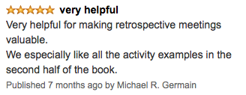
Close the retrospective
Amazon review:
Write a short Amazon style review on the retrospective with:
Star rating 1 to 5
Title
Content
Let everyone read out their review.
Record the star rating on a flip chart.
HOW?

Slide 42
Close the retrospective
Important:
Facilitators value feedback to, so before you end, take a few minutes to perform a retrospective on the retrospective.
HOW?

Slide 43
Why this format?
Structuring your retrospectives this way will help your team to
Understand different points of view
Follow a natural order of thinking
Take a comprehensive view of the team’s current methods and practices
Allow the conversation to go where it needs to go, rather than predetermining the outcome
Leave the retrospective with concrete action and experiments for the next iteration
WHY?
Notes:
Structuring your retrospectives this way will help your team to

Slide 44
WHAT?

Slide 45

Tips & Tricks
WHAT?

Slide 46


Preparation
A retrospective takes preparation time
How much?
WHAT?

Slide 47

Preparation
Prepare to throw your plan away.
WHAT?

Slide 48
Preparation
But keep facilitating.
WHAT?

Slide 49

Preparation
Ask for help:
A colleague.
A Scrum master from another team.
An agile coach.
The agile community.
WHAT?

Slide 50
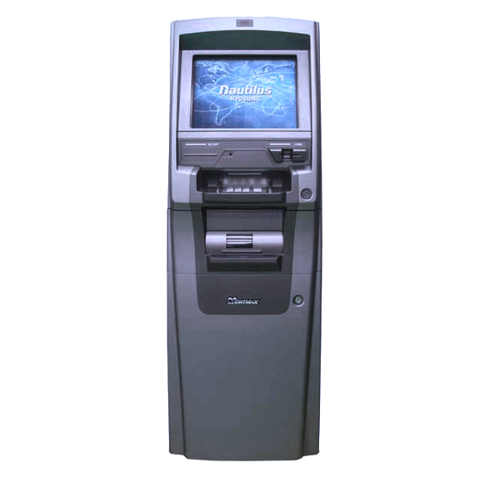
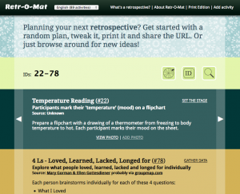
Preparation
The Retro-Mat: http://www.plans-for-retrospectives.com
WHAT?

Slide 51
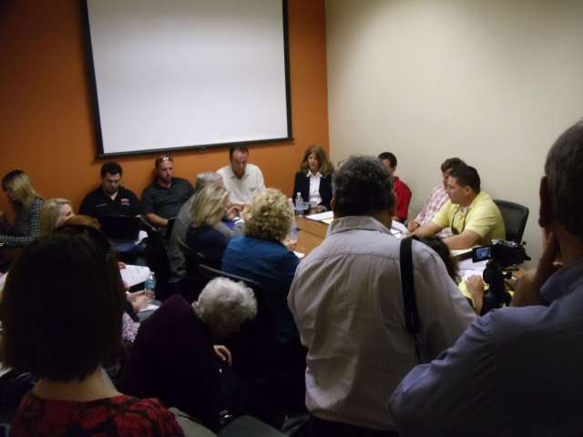
Location & Environment
WHAT?

Slide 52
Location & Environment
Pay attention to the location and environment:
Get rid of meeting room tables.
People should be able to move freely.
Light and oxygen.
Facilitation supplies galore.
WHAT?

Slide 53



Location & Environment
Snacks
Music
WHAT?

Slide 54
Location & Environment
But we don’t have suitable locations.
Be creative:
Atrium.
Canteen.
Local restaurants and bars.
Roof terrace.
WHAT?

Slide 55

Variation
WHAT?
Notes:
Using the same format over and over again endlessly will get people bored.
Boredom in retrospectives is one of the worst things you can have. Bored people are not fully engaged in the retrospective and won’t contribute.

Slide 56
Variation
100+
retrospective formats available
WHAT?

Slide 57
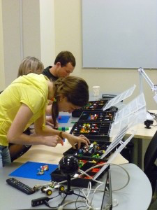
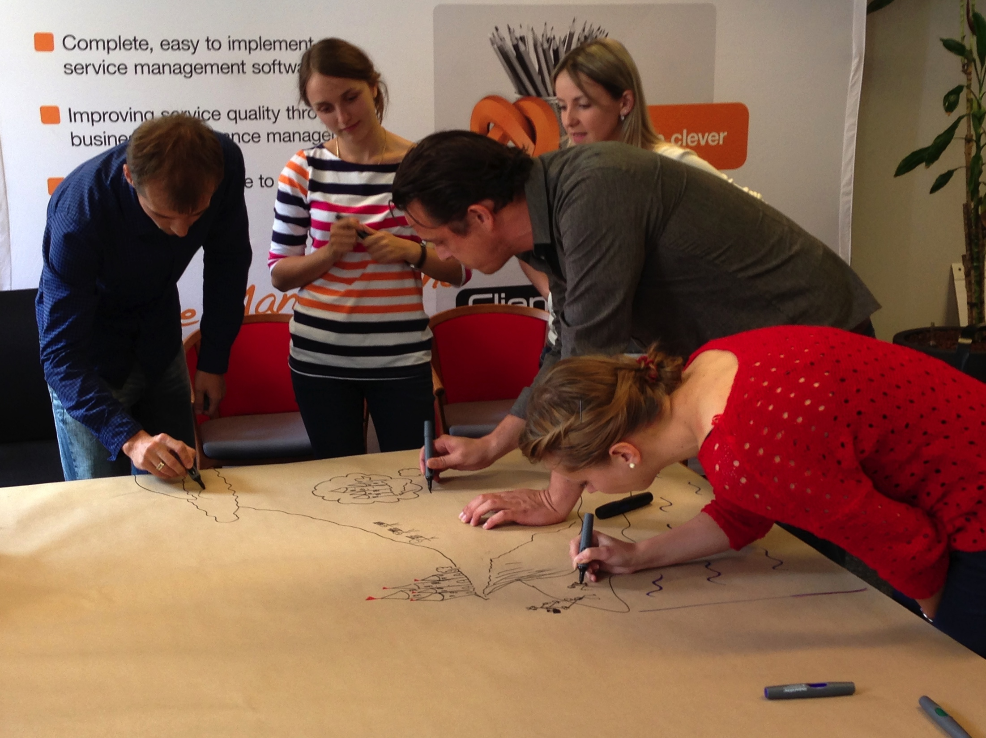

Variation
Trigger creativity.
WHAT?
Notes:
Triggering creativity will bring up discussions that would otherwise not surface.

Slide 58
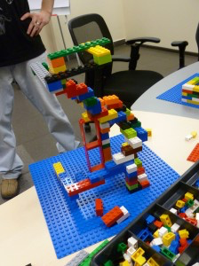
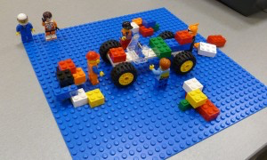
Variation
WHAT?

Slide 59
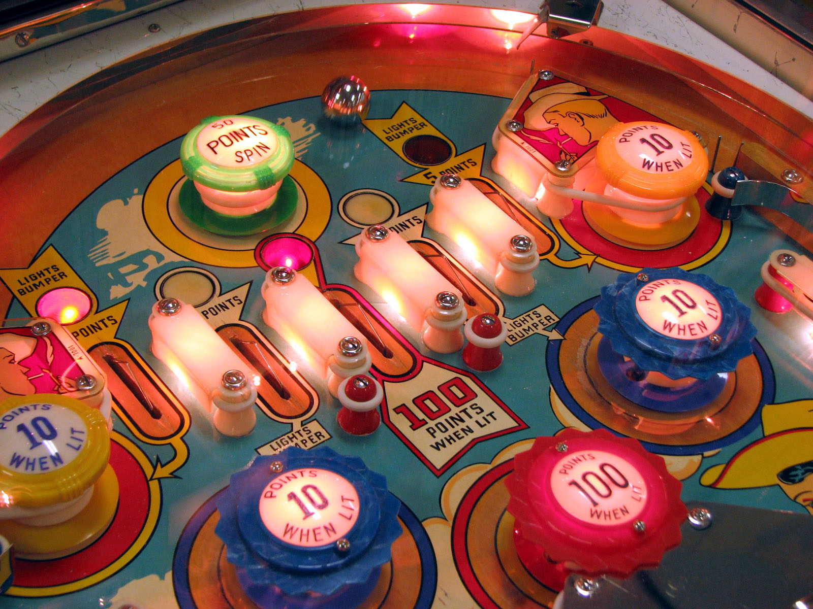
Variation
WHAT?
Notes:
You also don’t want to give people the feeling that they are in a pinball machine, bouncing in a different direction every time.
When bringing variation in your retrospectives, make sure to find a balance that accommodates the team.

Slide 60
Facilitation
Split up in small groups to get everyone’s input.
WHAT?

Slide 61
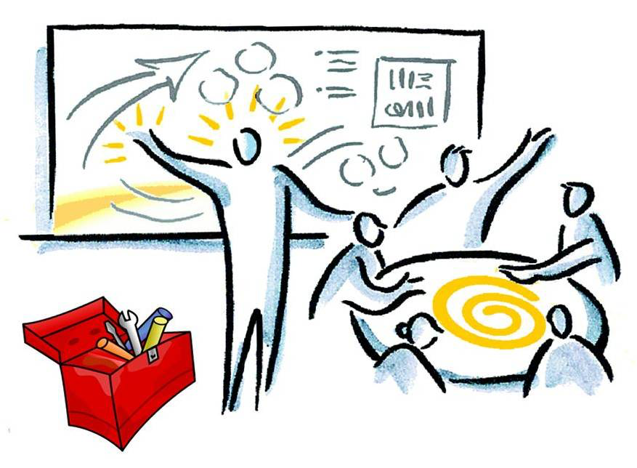
Facilitation
To facilitate or to participate, that’s the question.
WHAT?

Slide 62
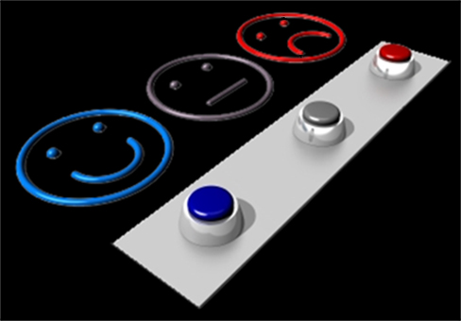
Facilitation
Evaluate yourself as a facilitator
WHAT?

Slide 63
Facilitation
Evaluate yourself as a facilitator
Example: close the retro with “helped, hindered, hypothesis"
WHAT?

Slide 64
Remote retrospectives
…..
WHAT?

Slide 65


Slide 66

Learning about retrospectives
A must read:
Agile retrospectives, making good teams great
Esther Derby & Diana Larsen
WHAT?
Notes:
A must read for everyone that is learning about retrospectives is the book from Esther Derby & Diana Larsen. This book will explain the basic structure of retrospectives as it is also used in this presentation and gives a large number of sample excercises for each phase of the retrospective.

Slide 67

Learning about retrospectives
Retrospective exercises
Availabe for free online on LeanPub https://leanpub.com/gettingvalueoutofagileretrospectives
WHAT?

Slide 68
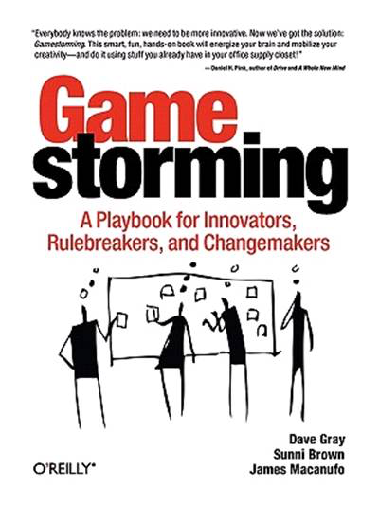

Learning about retrospectives
Useful work formats for retrospectives
WHAT?

Slide 69
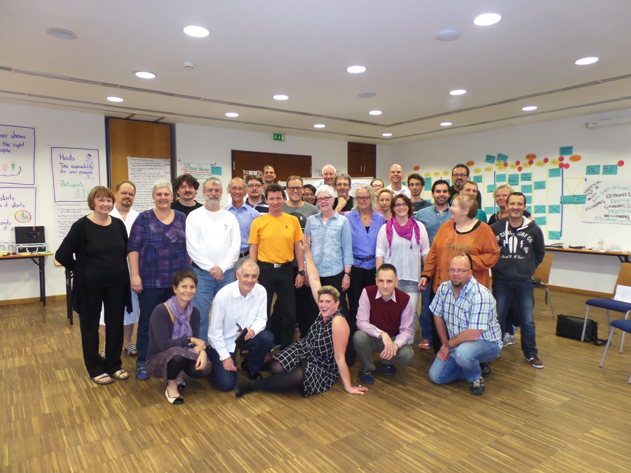
Learning about retrospectives
Retrospective
Facilitators
Gathering
WHAT?

Slide 70

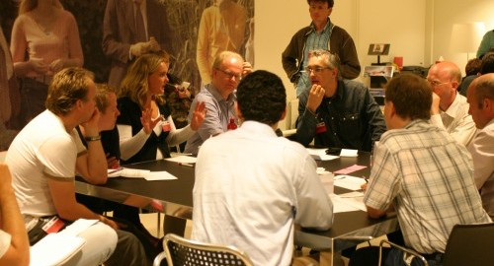
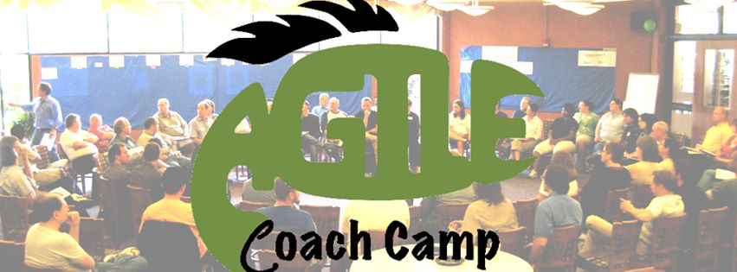
Learning about retrospectives
Agile Open Holland
WHAT?

Slide 71

?
Notes:
Questions?

Slide 72

Notes:
Questions?

Slide 73


More information
http://www.slideshare.net/muldersj
https://twitter.com/joostmulders

